Slide 1

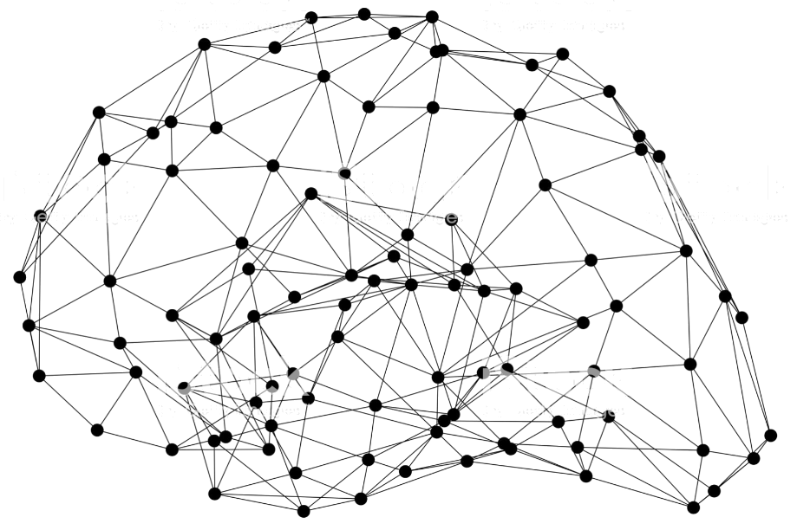
Deploy GluonCV models
Notes:
First call deck for a high level introduction to Apache MXNet.

Slide 2
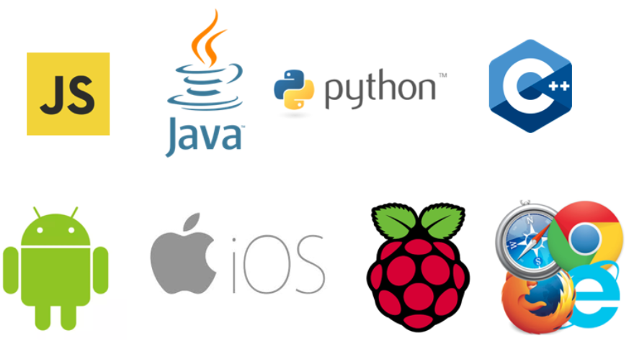
Models are not toys, they take effect after deployment

Slide 3

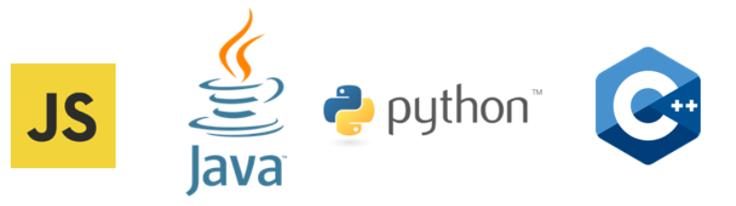
Deploy GluonCV Models
GluonCV Models
MXNet Computational Graph
Export As-is
Optimize with TVM
Json Acrylic Graph

Slide 4
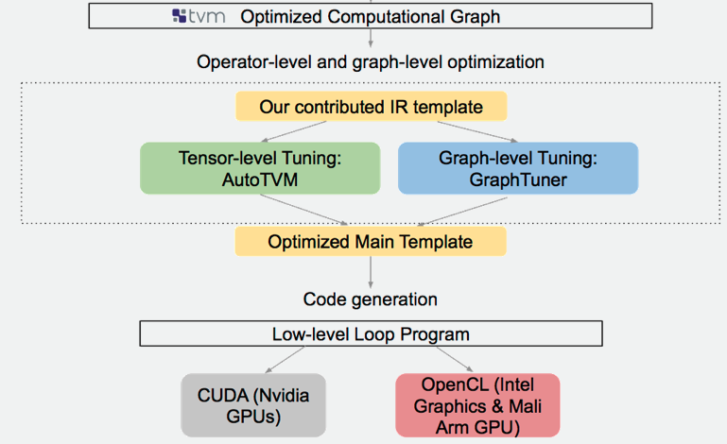
Optimize with TVM to speed up Inference

Slide 5
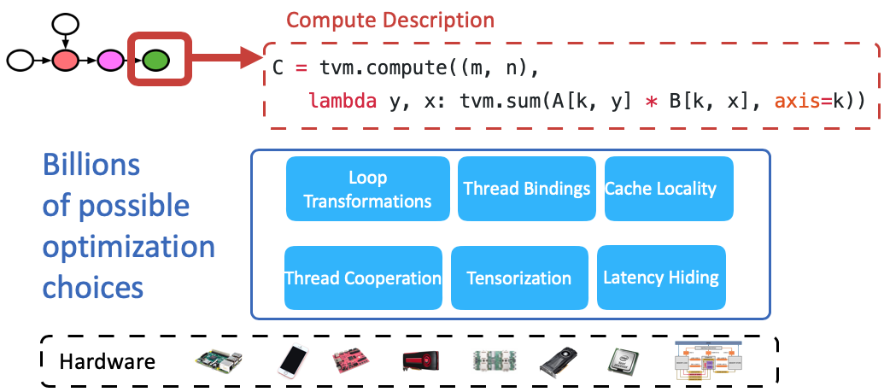
Automatic tuning

Slide 6
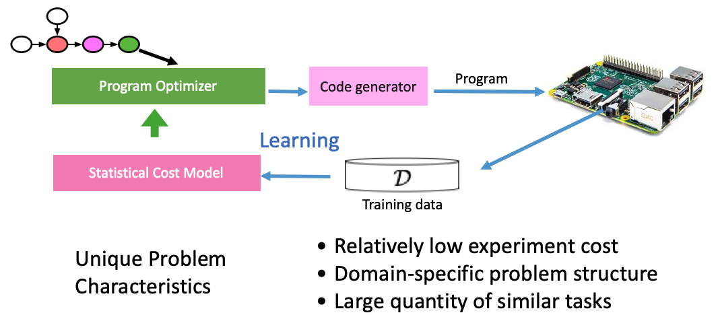
Learning-based Optimizer

Slide 7
Effects of Vision-specific Optimizations using TVM
AWS DeepLens
NVIDIA Jetson Nano
Acer aiSage

Slide 8
Effects of Convolution operators using TVM
AWS DeepLens
NVIDIA Jetson Nano
Acer aiSage

Slide 9
Hands On!

Slide 10
Like GluonCV? Go build!
https://github.com/dmlc/gluon-cv
https://gluon-cv.mxnet.io

